Slide 1

Importance of Information Technology in AI Product
Shanu Agrawal
Notes:
Introduce yourself, It is my pleasure to be here as keynote speaker, I am going to talk on importance of information technology in building successful AI product. First lets understand what is AI product

Slide 2
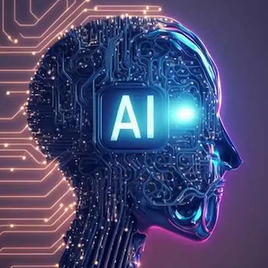
What is AI Product?
It is a software or hardware solution that utilizes AI algorithms to perform tasks that typically require human intelligence.
Recognizing Cat and dog images, driving, finding answer in document, Loan Default prediction
These products are designed to analyze vast amounts of data, recognize patterns, make predictions, and even learn from experience.
It can enhance decision-making, reduce human error, reduce repetitive tasks, and predict demand. This means more efficiency for working people and corporations.
Notes:
AI products leverage machine learning, deep learning, natural language processing, and other AI techniques to analyze data, make decisions, and execute actions. example of Spray Layout Design Parameters Whenever we get requirement from vehicle manufacturer need to convert them to manufacturing parameters how many hole, radius, plate thickness, spray angle and so one. And it requires lot of expertise and knowledge in product manufacturing design. Using the AI model, we can provide probable manufacturing parameters using the historical data. AI products also help in analyzing vast amount of data can creating insightful reports for example in supermarket just by showing how many items sold for each product on daily basis, which product group selling the most, using this they can Predict demand, reduce stockouts, and minimize overstock situations. Understand customer preferences, shopping patterns, and improve personalized marketing.

Slide 3
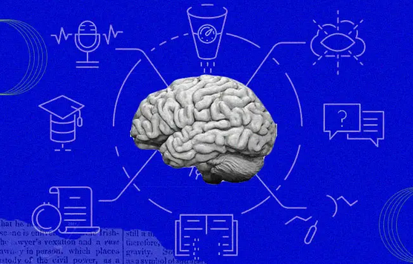
AI Products
Financial institutions are utilizing AI algorithms to detect fraudulent activities and make more accurate predictions in stock trading.
Entertainment industry, machine learning algorithms to suggest personalized content to users.
In healthcare sector, AI algorithms to detect anomalies in X-rays, MRIs, CT scans with high accuracy.
Social Media, Twitter uses AI to filter out hate speech and terroristic languages in tweets, personalized tweets
Notes:
And the most interesting thing is that AI is not domain/industry specific, its application can be everywhere. Beat Finance, beat healthcare, beat education, agriculture, social media.
This not only speeds up the diagnosis process but also helps doctors make more informed decisions
AI can also protect life of workers in risky jobs such as mining, firefighting and processing radioactive substances.

Slide 4
Beginning of AI
Most people think that AI is a recent scientific accomplishment. But its roots were laid down way back in the 1900’s.
1950 : Alan Turing’s paper called “Computing Machinery and Intelligence” starts with the question “Can machines think?”
1966 :Unimate, the first industrial robot in history
Eliza is the first natural language processing computer program designed between 1964 and 1966 at the MIT AI Laboratory by Joseph Weizenbaum
1997 – A computer beats human! IBM’s computer IBM Deep Blue defeated the world chess champion, Gary Kasparov, and became the first computer to beat a world chess champion.
Notes:
Due to the advancement's information technology, we see AI application everywhere. inUnimate was working with heated die casting machines. Its duty was simple but this duty was dangerous for workers to do and they could have hurt or lost their limbs if they carried the task. Therefore,using Unimate was more practical and safer. Besides, Unimate was able to carry the task quickly. Thanks to Unimate robots, General Motors have changed the automotive industry forever
https://www.formica.ai/blog/brief-history-of-ai-artificial-intelligence

Slide 5
2006 – Companies like Facebook, Google, Twitter, Netflix started using AI.
2008 – Google made a breakthroughs in speech recognition
2011 – Watson – an IBM computer, won Jeopardy in 2011, a game show in which it had to solve complicated questions and riddles.
2012 – Andrew Ng, the Google Brain Deep Learning project’s founder, fed 10 million YouTube videos into a neural network using deep learning algorithms.
2014 – Amazon’s Alexa was released.

Slide 6
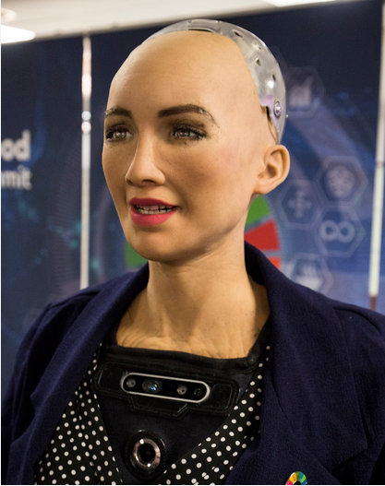
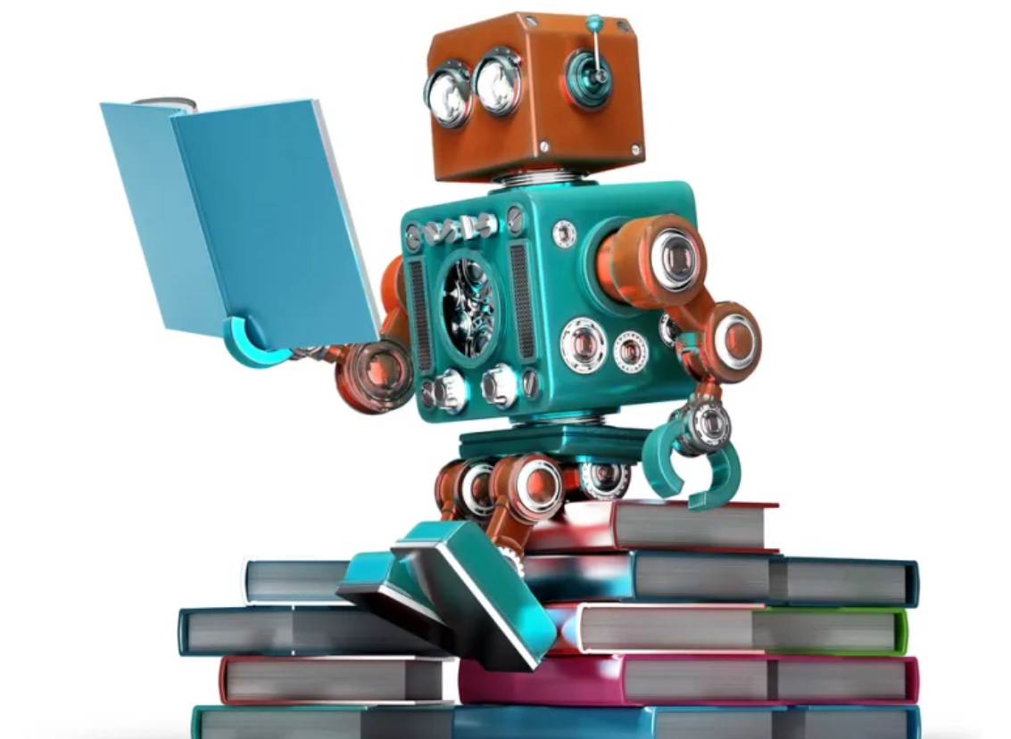
2016 – Hanson Robotics created the first “robot citizen,” Sophia, a humanoid robot capable of facial recognition, verbal conversation, and facial emotion.
2018: A Chinese tech group called Alibaba’s language-processing AI beat human intellect on a Stanford reading and comprehension test.
2020: OpenAI started beta testing GPT-3, a model that uses Deep Learning to create code, poetry, and other such language and writing tasks.
Notes:
The test generated questions about set of Wikipedia articles, where humans and AI programs were made to read a passage from over 500 Wikipedia articles and answered a series of questions regarding what they read.

Slide 7


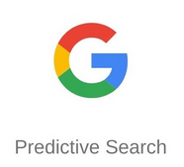






Notes:
Now we cannot imagine the day without using any of this tool, ChatGPt is product from Open AI, capable of understanding and generating human-like text based on the input they receive.Google uses AI in its predictive search. When you start typing on Google to search something, Google makes some recommendations. It uses past user data to predict what a user would type next in the search bar. Youtube uses past user data to recommend what movie a user might want to see next, making the user hooked onto the platform and increasing watch time. AI is used everywhere by large organizations to make an end user’s life simpler. Now let’s understand how all this tool learns and related with information technology

Slide 8
How all this tools Learns
Problem Definition and Understanding :Define clear objectives and success criteria for the project
Data Collection: The learning process starts with collecting relevant data. This data could be both structured (e.g., databases, spreadsheets) and unstructured data (e.g., text, images)
Data Preprocessing: Raw data is often noisy or contains irrelevant information. Data preprocessing involves cleaning and transforming the data to make it suitable for training.
Exploratory Data Analysis: Visualize the data using graphs, charts, and statistical summaries to understand its distribution, patterns, and relationships.
Notes:
It starts with Acquire both structured (e.g., databases, spreadsheets) and unstructured data (e.g., text, images) as required.
This may include handling missing values, normalizing data, and converting data into a format that the model can understand.

Slide 9
How all this tools Learns
Model Selection & Training: Choose appropriate machine learning algorithms based on the problem type (classification, regression, clustering, etc.).
Model Evaluation: Evaluate model performance using appropriate metrics (accuracy, precision, recall, F1-score, etc.) on the test set.
Deployment: Once the model is trained and validated, it is deployed to make predictions on real-world data. This could involve integrating the model into a production system or using it as a standalone application.
Monitoring and logging
All these requires strong backend infrastructure for data storage, communication, processing, user interface. And also, now possible due to advancements in IT industry.
Notes:
No matter how good the AI model if not deployed properly in will be no use. Like In supermarket you have created code for software recommendation and future demand when user is raising the request for product that time only should the stock level, future demands, and recommended products. Otherwise it will not be use also it has be quick it not like after an hour we provide. Currently in Bosch I am working in Anomaly detection production, we have to proactively detect failures in production line to avoid production downtime. It is done using showing the abnormal behaviour in stations, could be abrut shift in measurements values, gradual change or bunching of outliers near the threshold. It also has be quick, It has only possible due to advancements in Information technology. Will Highlight the advancement which are making AI products successful.
It's important to note that the learning process is iterative. If the model's performance is not satisfactory, the process may be repeated with additional data, adjustments to the model, or changes to the learning approach. The continuous learning and improvement over time are key characteristics of machine learning and AI systems.

Slide 10
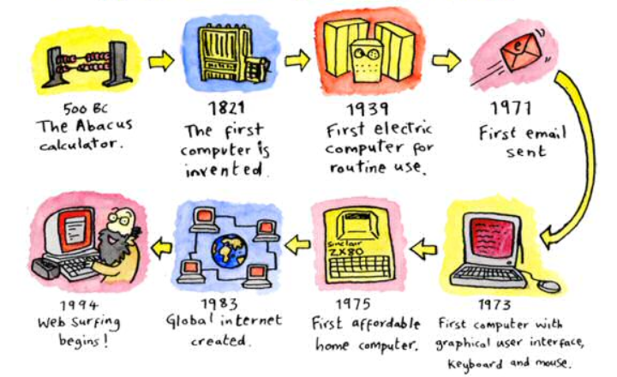
Notes:
During the first generation, computer systems used vacuum tubes. The machines were huge and took up entire rooms. They consumed a large amount of electricity and therefore, were expensive to operate. They also generated a lot of heat which resulted in malfunctions.
In the second generation, vacuum tubes were replaced with transistors. This was a major improvement, allowing computers to become smaller, faster, cheaper, reliable and more energy-efficient.
By the time the third generation arrived, there was an increase in the speed and the efficiency of computers due to the development of integrated circuits. Fourth generation computers upscaled to integrated circuits that contained a numerous amount of transistors on one, small chip. Microprocessors contained memory, logic and control circuits (central processing unit) on a single chip. Computer systems went from enormous vacuum tubes that filled an entire room to a tiny chip that could fit in your hand. Computers like IBM and Apple PC (personal computer) were created for both personal and business purposes. La

Slide 11
IT is Backbone
Since the invention of the world wide web, the IT realm has quickly expanded. When information technology started supporting artificial intelligence, it become easier to incorporate AI into business. Here are IT tools helping the AI world:
Storage capacity: AI heavily relies on large datasets for learning. IT infrastructure facilitates the storage, retrieval, and management of massive amounts of structured and unstructured data.
Computing performance : AI Requires high performance computing resources, including CPUs, GPUs, and TPU’s, Big data technologies, like Apache Spark and Hadoop, are crucial for handling and analyzing vast amounts of information.
Networking infrastructure: Fast and reliable networking infrastructure is crucial for data transfer between components also Reduced latency is essential for real-time AI applications (HTTP based RESTful API)
Notes:
High-Performance Storage: Fast and scalable storage solutions are essential for handling large datasets used in training machine learning models.
Distributed File Systems: Distributed file systems like Hadoop Distributed File System (HDFS) or cloud-based solutions enable efficient storage and retrieval of data.

Slide 12
IT is Backbone
Security: IT plays a critical role in ensuring the security of AI systems, protecting data, models, and user privacy.
User Interface : The design of AI user interfaces plays a crucial role in making complex technologies accessible, understandable, and user-friendly.
Monitoring and Maintenance : IT tools provide monitoring and logging capabilities for AI applications.
Cloud Computing : Cloud platforms (e.g., AWS, Azure, Google Cloud) provide scalable and on-demand computing resources. AI developers can leverage cloud services for data storage, processing, and deployment, reducing infrastructure management overhead.
Notes:
Auto-Scaling: The ability to dynamically adjust resources based on demand ensures optimal performance and cost efficiency.
Load Balancing: Distributing incoming network traffic across multiple servers prevents overload on individual components.

Slide 13
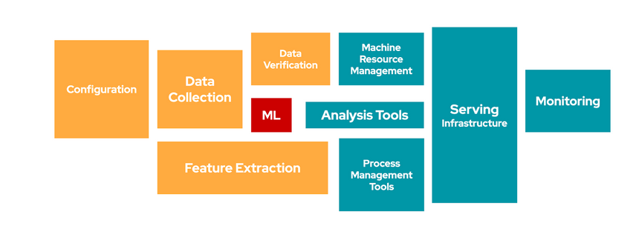
The Importance of Information Technology
Google, in its discussion Hidden Technical Debt in Machine Learning Systems, highlights that the actual ML is only a small element in an effective workflow. Success in delivering AI/ML requires a coordinated approach across a range of IT disciplines
Notes:
https://proceedings.neurips.cc/paper_files/paper/2015/file/86df7dcfd896fcaf2674f757a2463eba-Paper.pdf
Manufacturing, product recommendation, when placing the order pop up for optimized quantity to order resulting in inventory reduction, real time

Slide 14
AI now and in the future
Advances in artificial intelligence show no signs of slowing down - the world is changing rapidly, and as we move even further into an era dominated by artificially intelligent technology, the advancements in IT industry are important
While AI is powering its way into the present and future of computing technologies, there are still significant challenges to overcome.
And major part of it goes to setting up an infrastructure where you can run AI tools. Only after building a robust AI infrastructure, the benefits of AI and ML models can be reaped.
Notes:
, processing thousands of terabytes of data on a daily basis to build predictive models of consumer behavior. It has already made their way into everyday life, helping us save time and energy.

Slide 15
AI now and in the future
Tech giants such as Google, Meta and Amazon, have been utilizing machine learning to make constant advancements and successful as they have infrastructure for data storage, processing, modelling, Monitoring and Response time.
But still for lot of companies, to use AI setting up the right infrastructure is challenge.
This is where I think, IT engineers can help companies in setting up the right infrastructure
Notes:
Today, for all the successful products like ChatGPT, Weather Forecasting, Smart Replies, or Smart Recommendation, backbone is best infrastructure for data storage, processing, modelling, Monitoring and Response time.

Slide 16
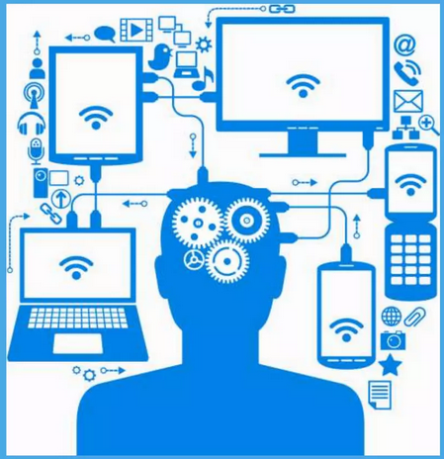
IT can exist without AI but
AI can’t exist without IT

Slide 17


Slide 18
Career
Tech careers are considered one of the fastest-growing professions. A degree in Information technology is of good value since it has a very high return on investment.
Information technology has made a major impact in our lives. Today there is hardly any field which is not benefited by computers. It is helping every field to grow and develop.
It has led to creation of a number of job including computer programmers, data engineer, system analyst, software developer, web designer, Devops etc.

Slide 19
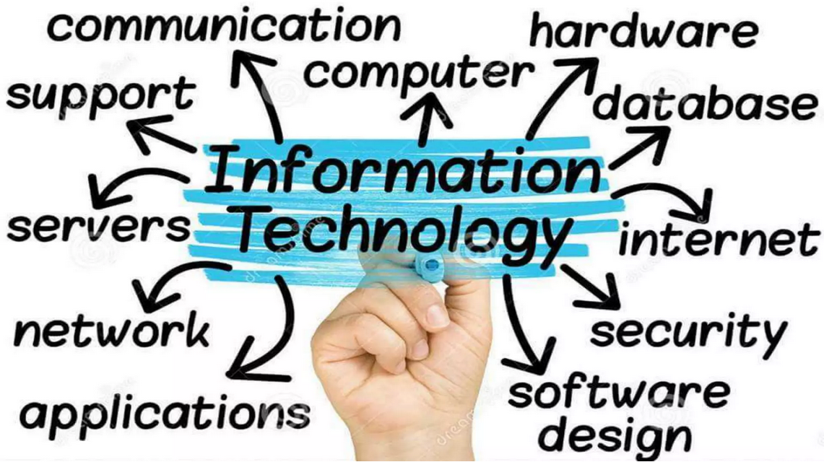
Xxxxxxxx gn5tyy7/^/56tygF ‘4321111~wwr54edfe4fffffffffffffffffffffffcdr

Slide 20
Thank You

